Slide 1




TASK PULSE
BY HITESHI JOSHI AND KIRANDEEP KAUR

Slide 2

Company Profile
O7 Services is an ISO 9001:2015 Certified company founded in 2015. They specialise in a variety of services including Web Development, Mobile Application Development, Custom Software Development, UI/UX Designing, Hosting services, Digital Marketing, Registration of Domain Names with various extensions, AMC & MMC Services, Bulk SMS and voice calls. O7 Services offers advanced IT solutions supporting the entire business cycle - from consulting to system development, deployment, quality assurance, and 24x7 support. With over 9 years of experience, the company aims to form long-lasting strategic partnerships with clients, offering affordable prices, timely delivery, and measurable business results. Their headquarter is located in Jalandhar with a branch office in Hoshiarpur.

Slide 3

Table Of Contents
Drawback of Existing System | To compare the drawbacks of systems already made with our project.
Project Explanation | An overeview to what is project about.
Modules | To show how many main screens we have in our project.
Technology Used | Technologies and soft wares which are used to make the project.
Screenshots | Snapshots of main screens which have been made in our project.
Thank you | Thank you slide.

Slide 4

01
Drawbacks of Existing System

Slide 5
1
2
3
Insufficient customization
Difficulty in integrating with other tools and software
High subscription fees.

Slide 6

02
Project Explanation

Slide 7

It is very necessary to maintain an employee’s updates for a company’s main head.
In this Project, the main aim is to manage the role of each and every employee by the admin by assigning them projects ,tasks and handling the employees data by inserting and deleting records of employees.

Slide 8

03
Modules

Slide 9

Admin Panel
Employee Panel

Slide 10
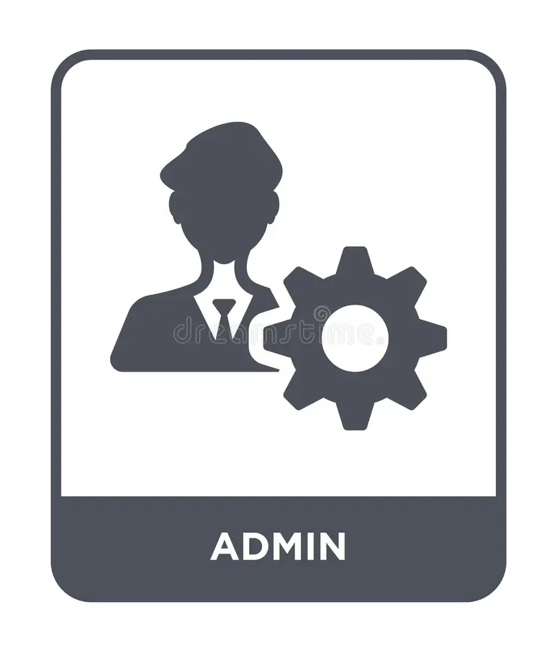
Admin Functionality
Login
Manage Employees
Manage Projects
Manage Tasks

Slide 11

Employee Functionality
Login
View Tasks

Slide 12

04
Technology Used

Slide 13
SQL DATABASE
01
02
03
CORE JAVA
XAMPP CONTROL PANEL

Slide 14
05
Screenshots

Slide 15

Main Screen

Slide 16
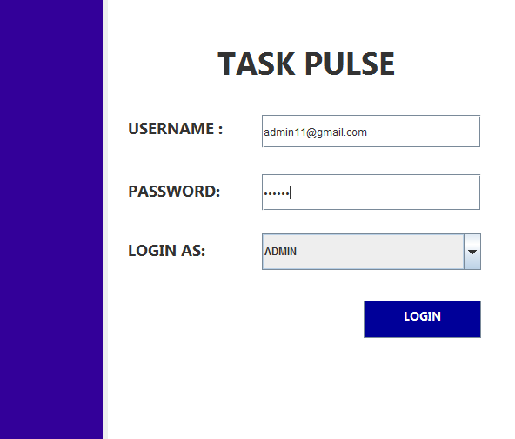
Admin
Login

Slide 17
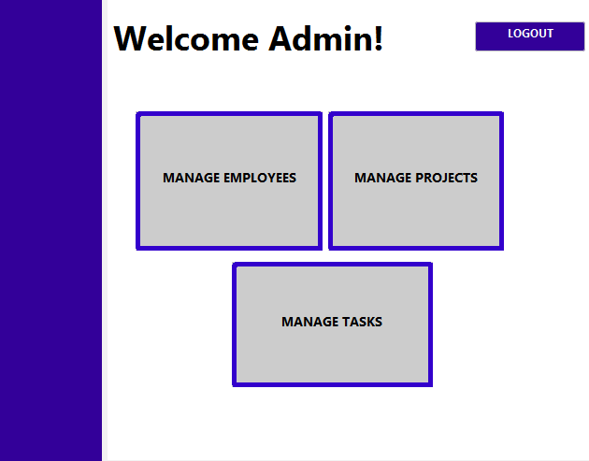
Dashboard
Admin

Slide 18
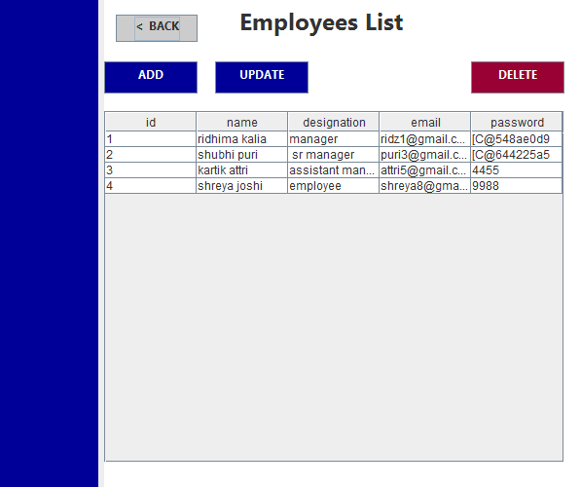
Manage Employees

Slide 19
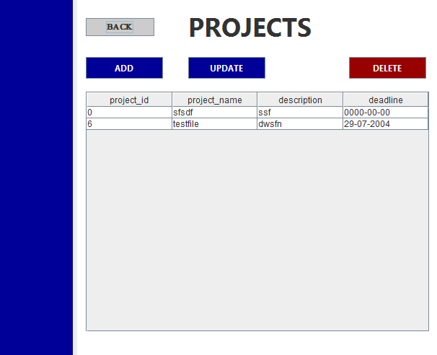
Manage Projects

Slide 20
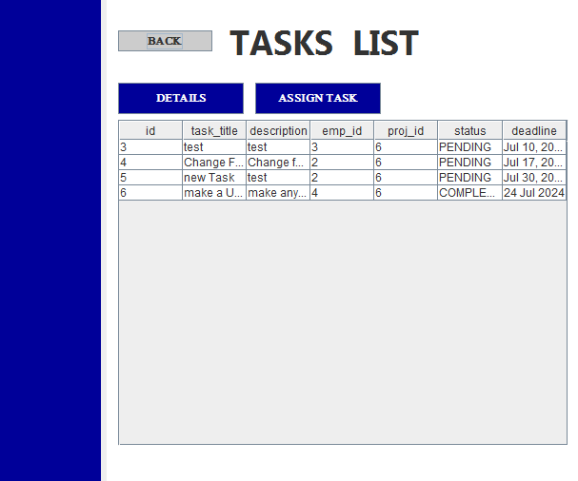
Manage Tasks

Slide 21
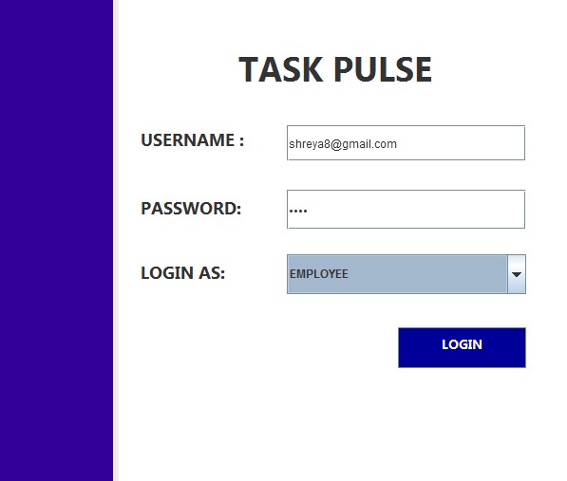
Employee Login

Slide 22
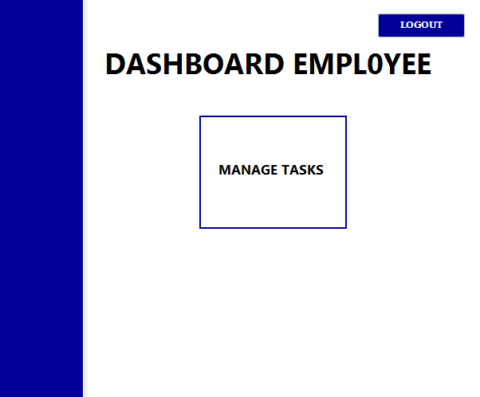
Dashboard
Employee

Slide 23
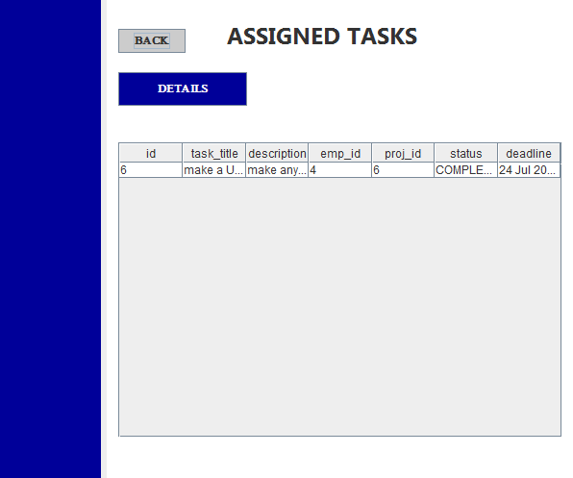
Particular Employee’s Assigned Task Details

Slide 24
THANK YOU !

